Slide 1
Intro to CAD

Slide 2
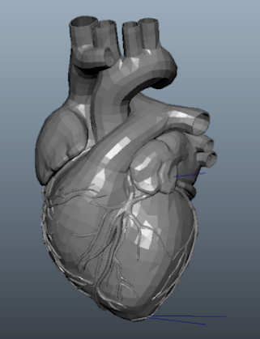
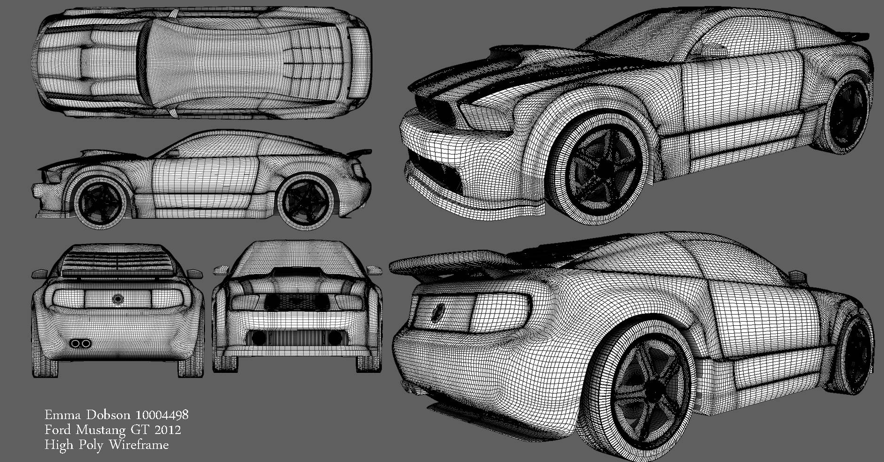
Intro to Computer Aided Design (CAD)
What Do you Already Know About CAD?

Slide 3




What is Computer Aided Design
CREATE
Computer Aided Design (CAD)- create, modify, analyze, and optimize a design
Diagrams with details useful to manufacturing the design
2D or 3D form
contain information (dimensions, materials, tolerances, and processes)
MODIFY
ANALYZE
OPTIMIZE
Notes:
Computer Aided Design is using software programs and technology to Create, Modify, Analyze, and Optimize designs
-Create=draft the original design
-modify= making different changes to the design
-analyze= use the design dimensions and properties to determine unknown properties and compare
-optimize=choose design dimension and properties that create the best situation for the model (ex: uses least amount of material, burns least amount of fuel)
There are different softwares to CAD based on what you want to do, we are using Fusion360

Slide 4
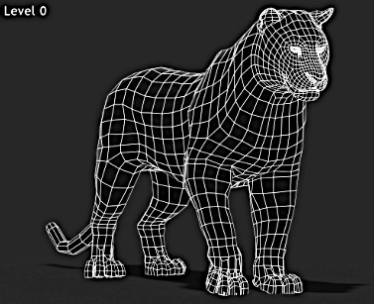
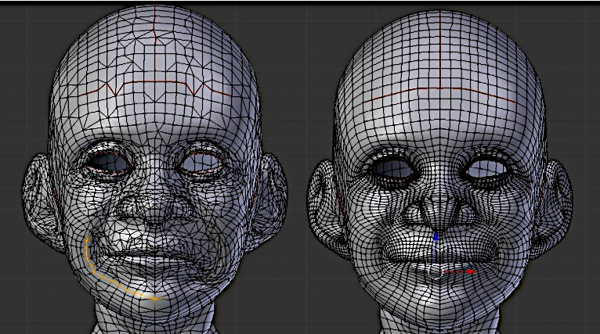
Why is CAD Important?
Quicker and more Flexible
Increase Collaboration & Productivity
Uniform way to relay useful information (materials, tolerances, dimensions, and processes)
Show real life scaling and details when 3D printed
Notes:
All of these points are comparing Cad to designing by hand
Because Cad files are digital they are more easier to share, causing more collaboration and increased productivity
Information on Technical drawings made form CAD files are very useful to manufactuers
Showing real life scale and product details is often important to customers

Slide 5
Real Life Applications
Notes:
We want to emphasize that there are many different careers that use CAD, and the students don’t have to wait for the future to start. There are also a number of things they can model and print that will be useful to their everyday life now.

Slide 6
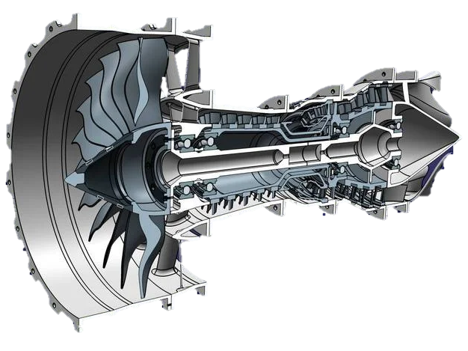
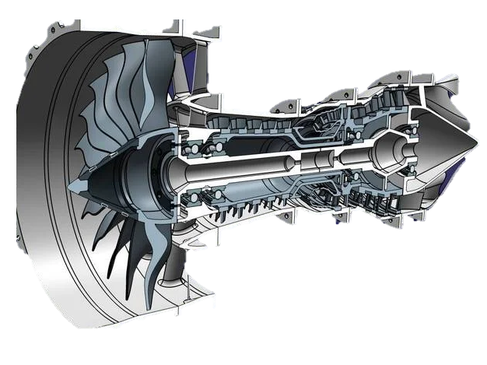
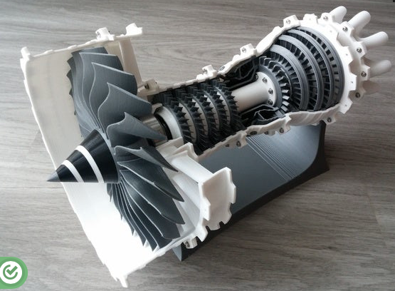
Modeling a Jet Engine
You can 3D print out a Mini Jet Engine model now! (file from Thingiverse)

Slide 7
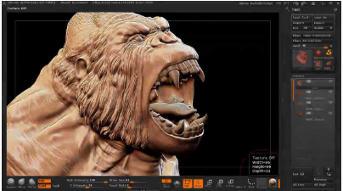

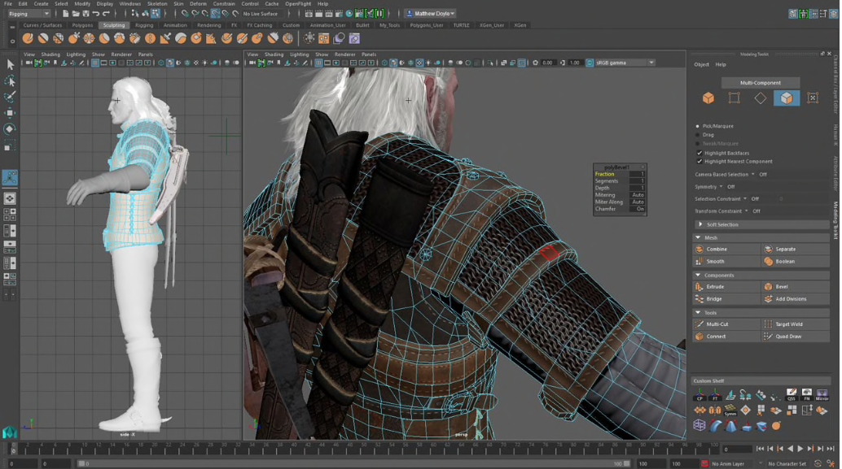
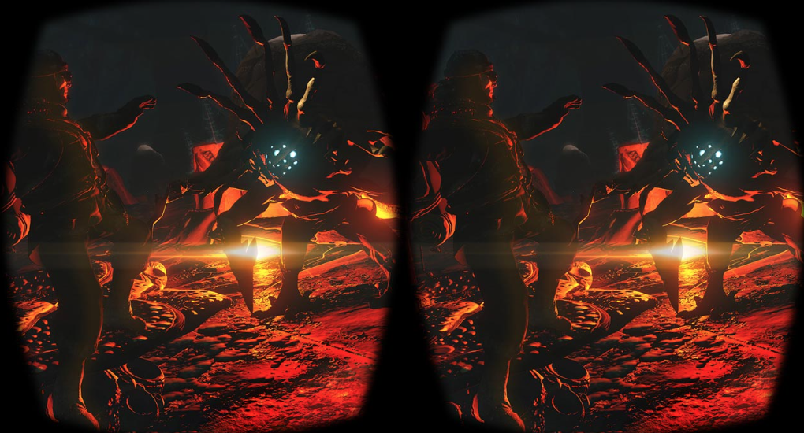
Computer Animation and Special Effects
Video Game Design
Virtual Reality

Slide 8
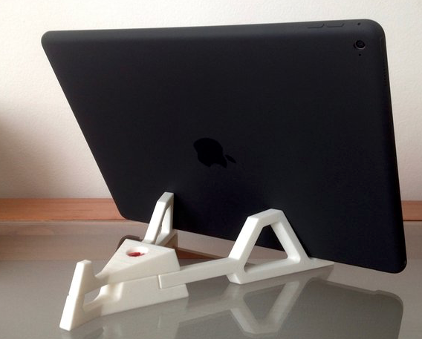
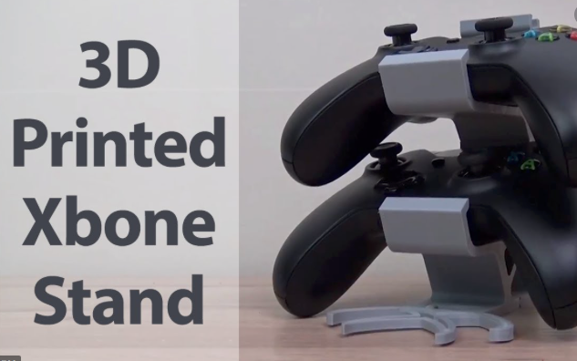
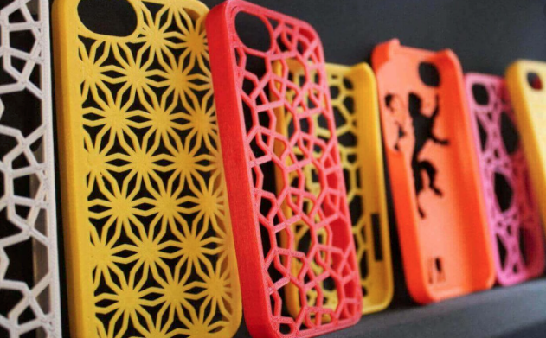
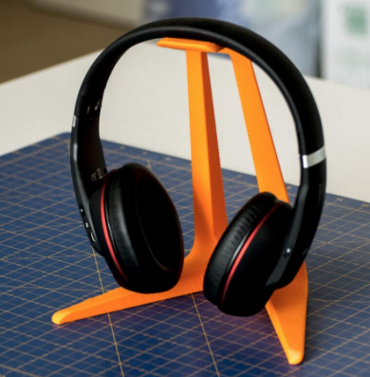
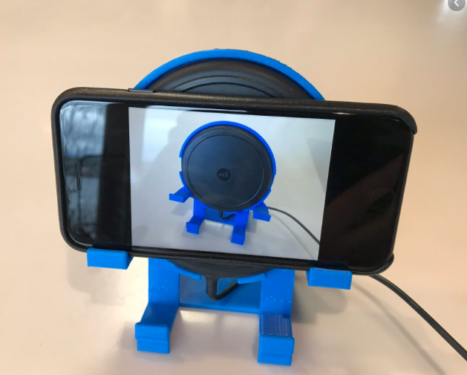
Make Your Own Electronic Accessories

Slide 9
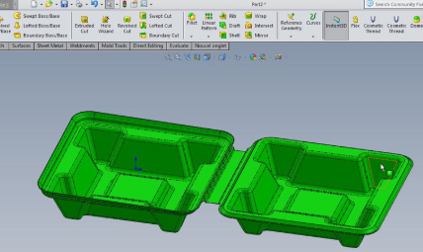
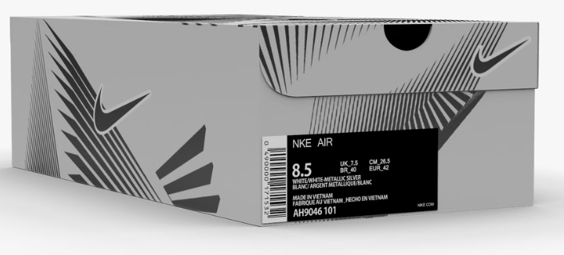
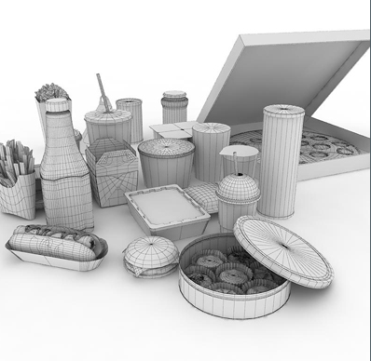

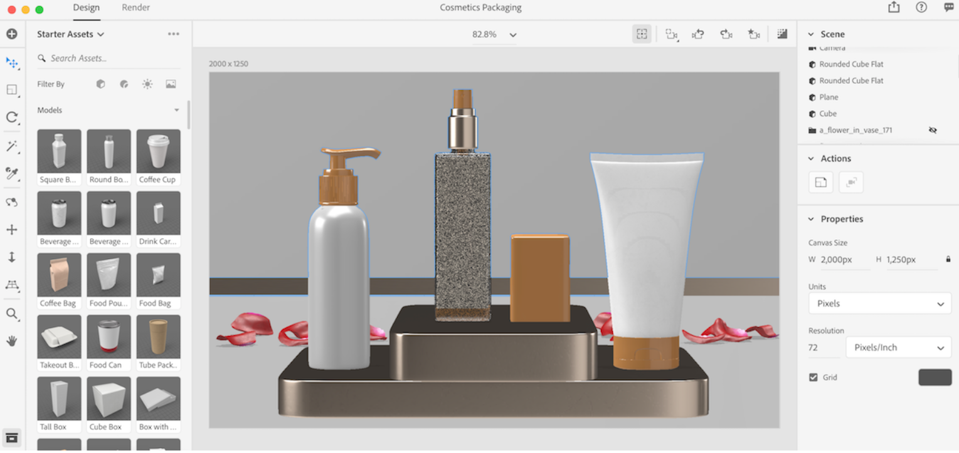
Design packaging of a product

Slide 10
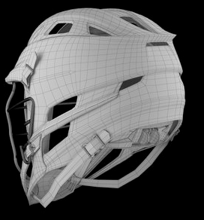
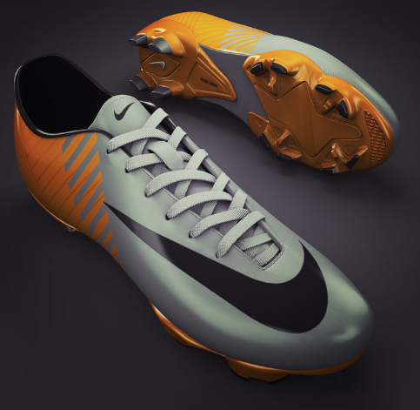
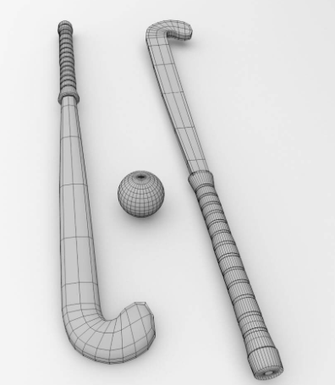
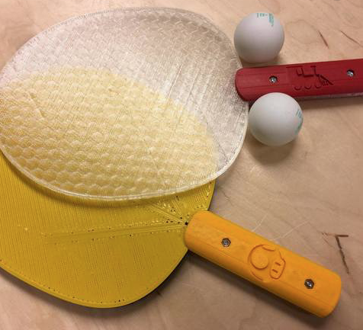
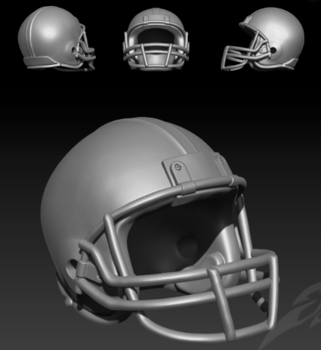
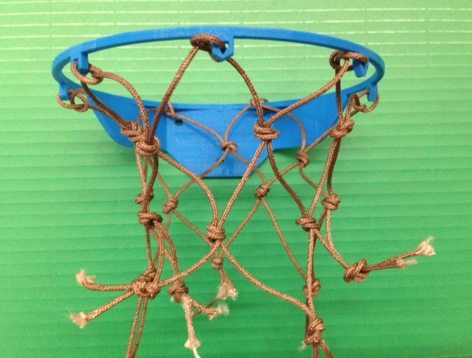
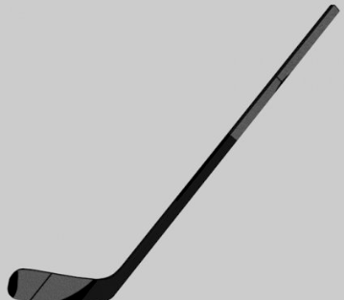
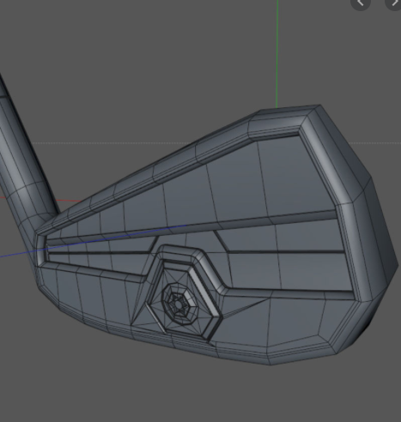
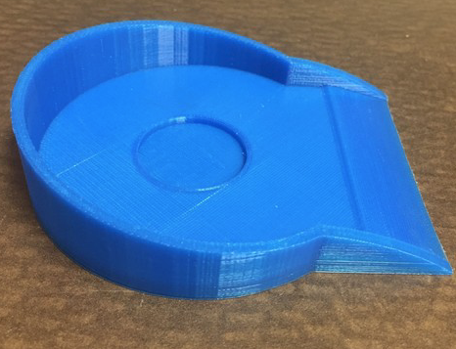
Sports Equipment Design
You can even make your own sports accessories now!

Slide 11
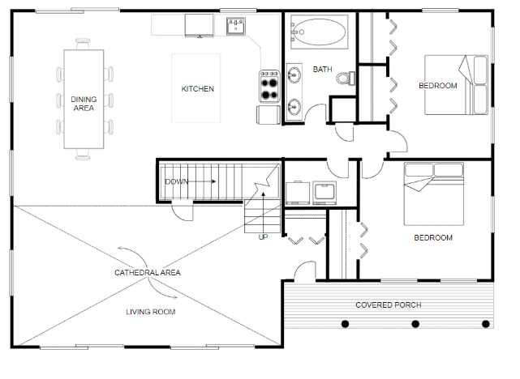

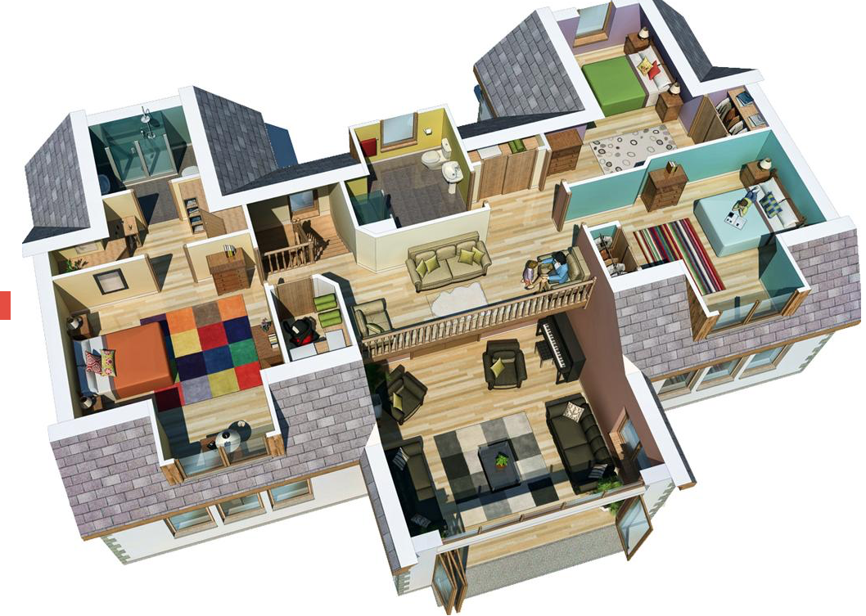
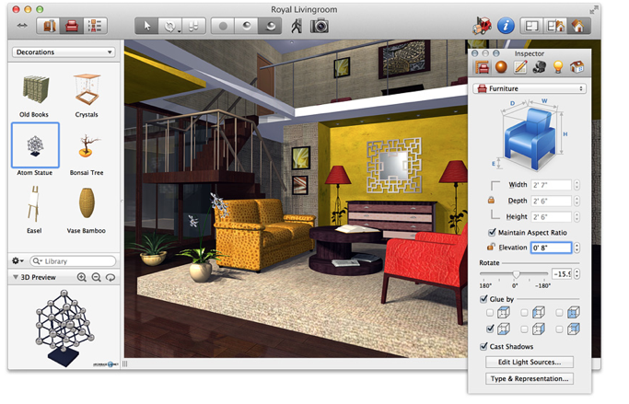
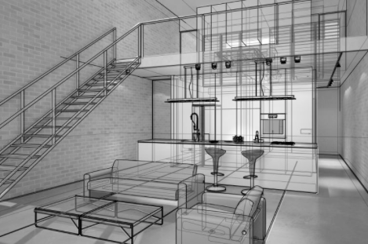
Floor Plans and Interior Design

Slide 12

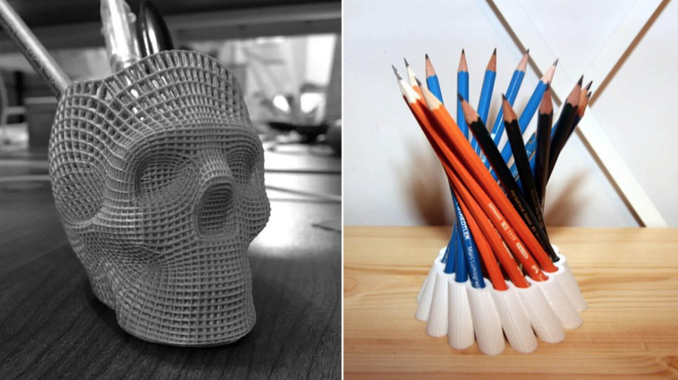

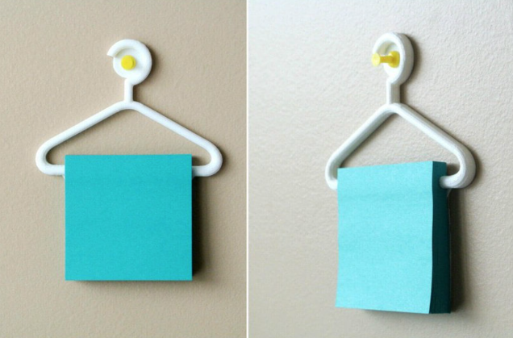
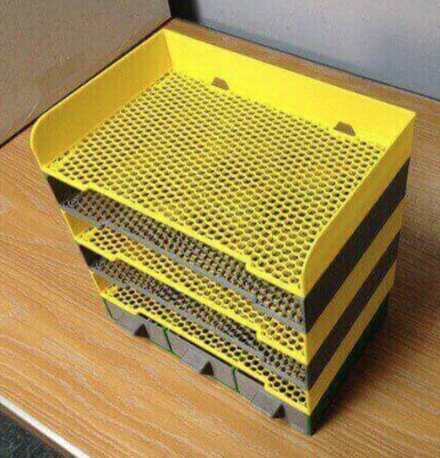

Making School Supplies

Slide 13
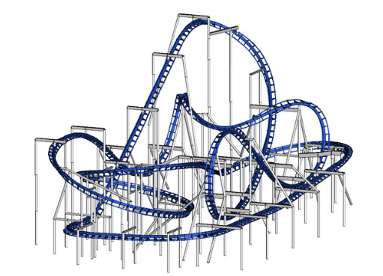
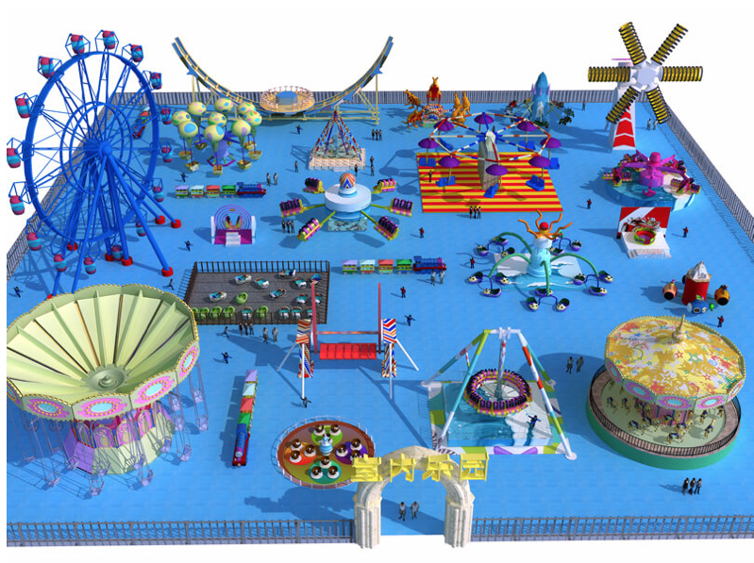
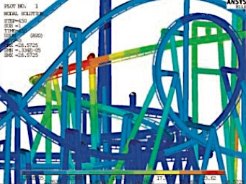
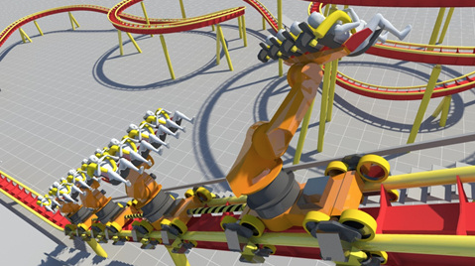
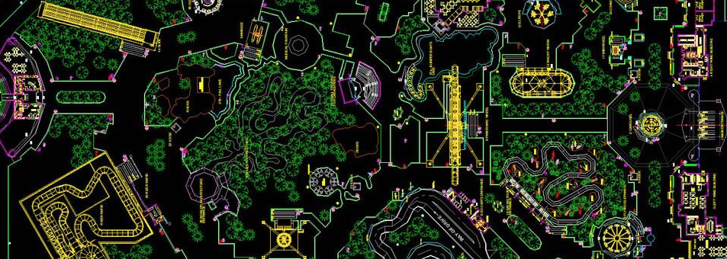
Amusement Parks

Slide 14
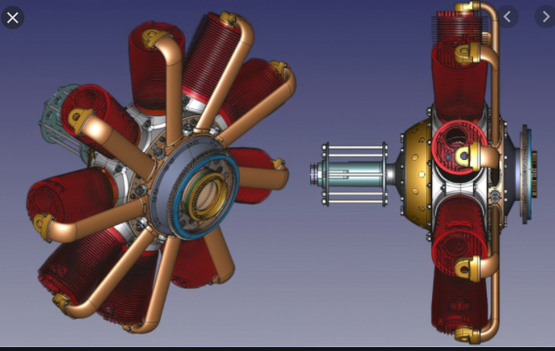
Progress Check
How would you describe CAD to someone?
Why is CAD more worthwhile than hand drawings and designs?
What other applications can you see CAD being used other than the ones mentioned above?

